Slide 1

Fake News Prediction
Akanksha Vejendla
MST03-0035
By, Urooj Khan

Slide 2
Fake News Prediction
Fake news is a big problem on the internet.
Fake news refers to false or misleading information presented as factual news content.
It can range from fabricated stories and conspiracy theories to deliberately misleading headlines and doctored images.
By using machine learning algorithms, it will be easy to tackle the problem of fake news detection.
Logistic Regression, Naïve Bayes, Decision Tree, Random Forest Classifier algorithms are used to classify whether the news are true or fake

Slide 3
Machine Learning Algorithms
The Algorithms used in the Fake News Prediction:
Logistic Regression
Naïve Bayes
Decision Tree
Random Forest Classifier
Evaluation Metric Used in the Prediction:
Accuracy

Slide 4
DATASET
The dataset consists of two CSV files, "fake.csv" and "true.csv", each containing 21,418 rows and four columns: title, subject, date, and text.
These files are structured to store information about news articles, with "fake.csv" presumably containing articles classified as fake or misleading, while "true.csv" holds articles verified as true or accurate.
The "title" column likely holds the headline or title of each article, providing a brief summary of its content.
The "subject" column likely categorizes the articles into different topics or domains, such as politics, health, or technology.
The "date" column likely records the date when each article was published or last updated, facilitating temporal analysis.
Lastly, the "text" column likely contains the main body of the article, providing the detailed information and content.

Slide 5
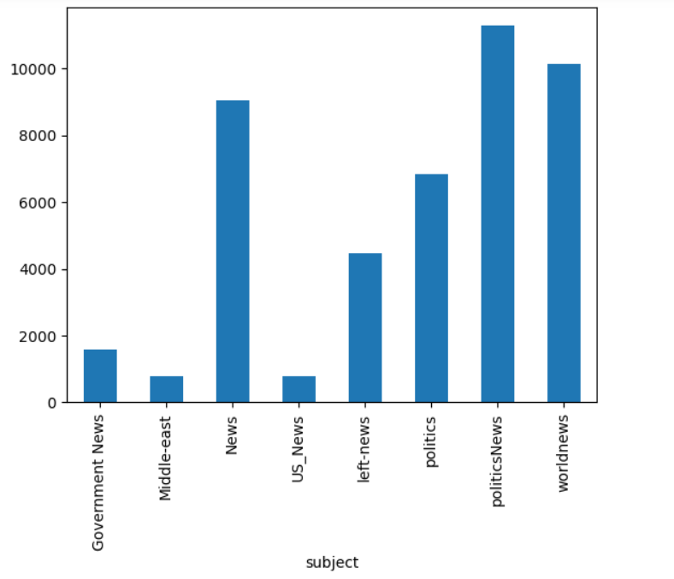
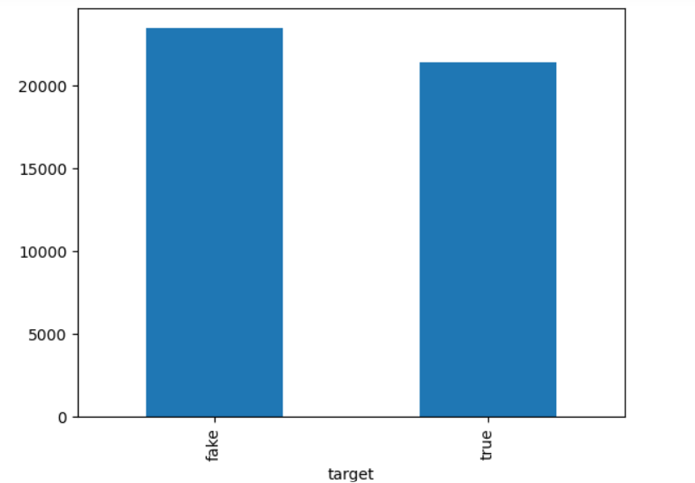
DATA VISUALIZATION

Slide 6
CountVectorizer
`CountVectorizer` is a feature extraction technique used in natural language processing (NLP) and text mining.
It works in three steps
Tokenization: It first tokenizes the text documents, splitting them into individual words or terms. This process involves removing punctuation and splitting the text into tokens based on whitespace.
Counting: After tokenization, it counts the frequency of each term in each document. It constructs a vocabulary of all unique terms in the corpus and assigns an index to each term.
Vectorization: Finally, it represents each document as a vector, where each element of the vector corresponds to the count of a particular term in the document. The length of the vector is equal to the size of the vocabulary.

Slide 7
TfidTransformer
The `TfidfTransformer` in scikit-learn calculates TF-IDF scores for terms in documents, indicating their significance by considering both their frequency in the document and rarity across the corpus.
This transformation is widely used in natural language processing tasks to represent text data in a numerical format that can be fed into machine learning algorithms.
The importance increases proportionally to the number of times a word appears in the document but is offset by the frequency of the word in the corpus.

Slide 8
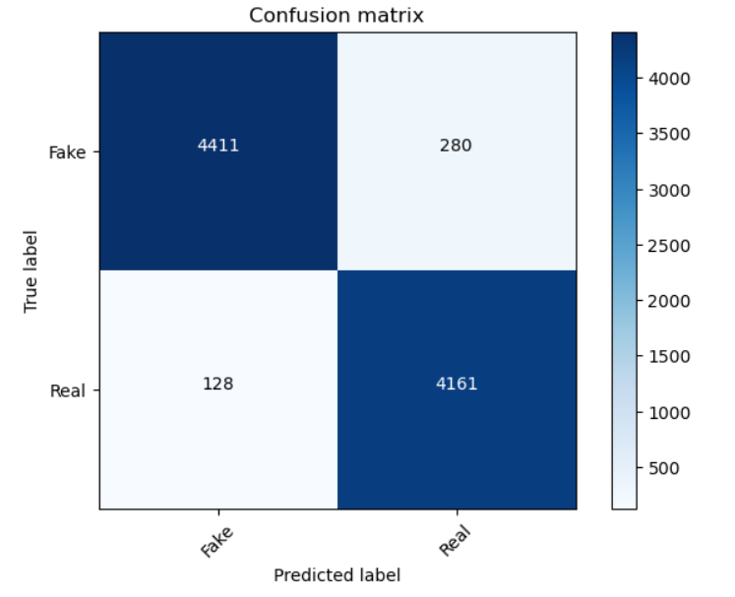
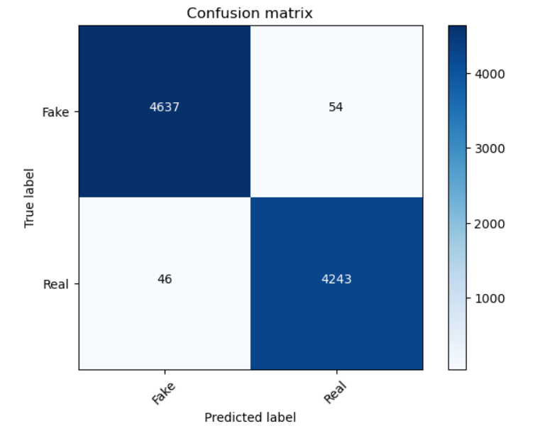
Confusion Matrix
Logistic Regression Naïve Bayes

Slide 9
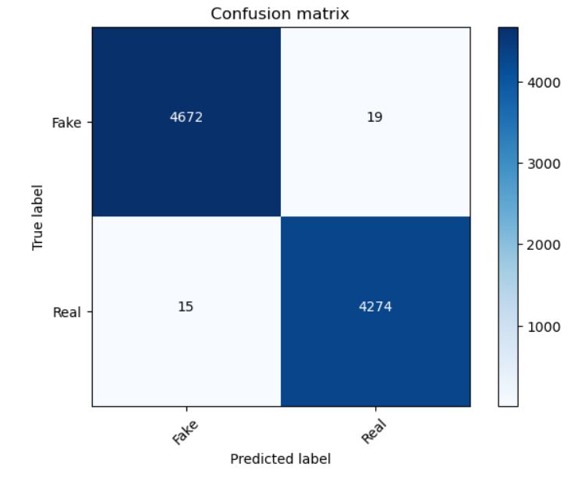
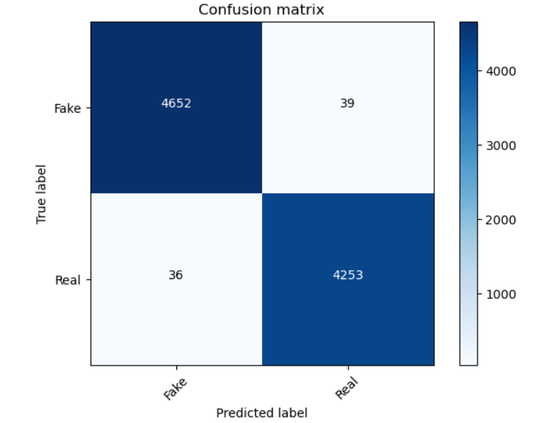
Confusion Matrix
Decision Tree Random Tree Classifier

Slide 10
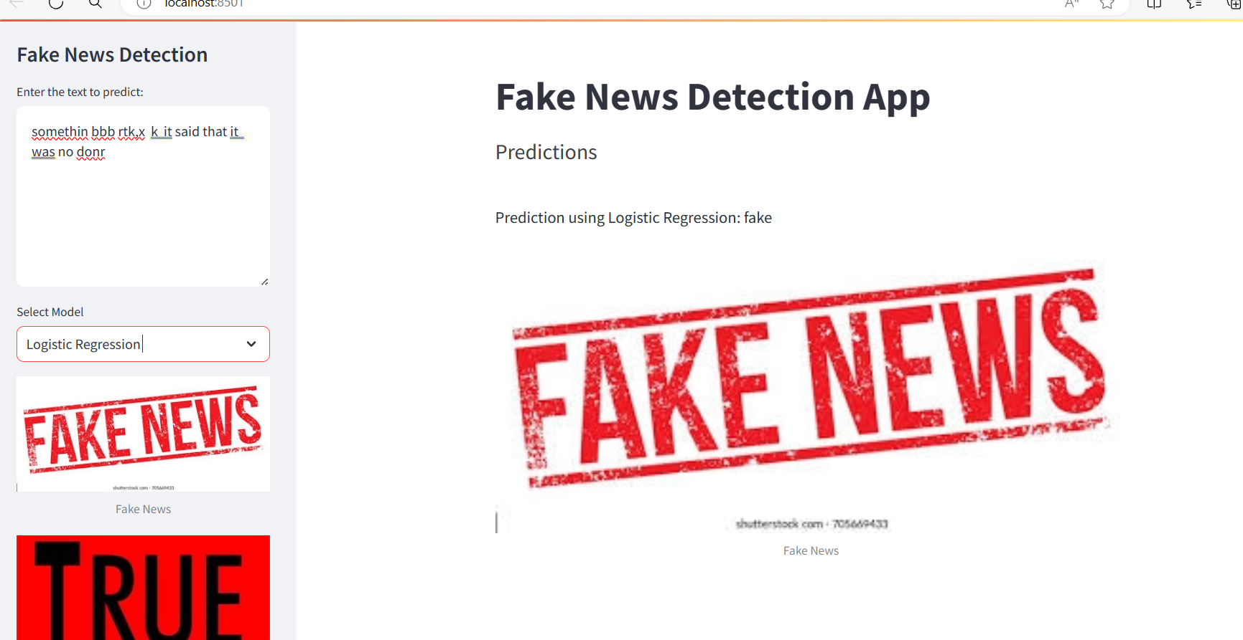
RESULT

Slide 11
CONCLUSION
Logistic Regression provides a simple yet effective approach, while Naive Bayes is based on probability and can handle large datasets well.
Decision Trees offer interpretability but may overfit the data, whereas Random Forest combines multiple decision trees for improved accuracy and robustness.
Overall, the choice of algorithm depends on the specific characteristics of the dataset and the desired balance between simplicity and performance.

Slide 12
Thank you

